Slide 1
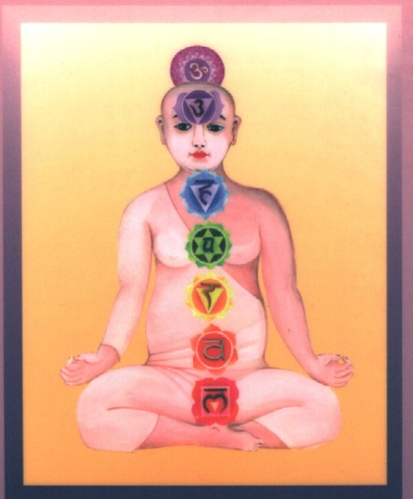
Research of the Human Body to its Core, which is the Sanskrit Alphabet –Devanagari
Postal Address:
PO Box 171
Richmond 7025,
Tasmania, Australia
m/61(0)414495051
e/om@sheshnaag.com
Michael Perring – omdevaji
Sheshnaag Yoga Centre
‘Share the World’

Slide 2
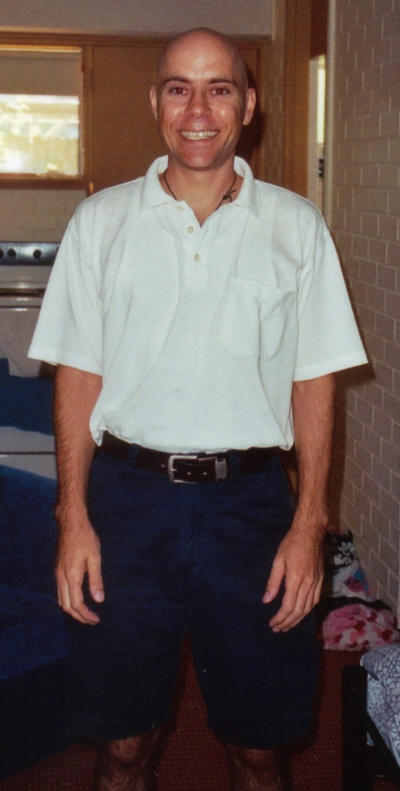
1998 Culturally ‘Normal’
School for twelve Years
Fell into the Profession
of Radiography (x-rays)
(learnt something to
repeat everyday for the
next forty five years and get paid for it )
Close circle of Friends
Relationship with girlfriend
Interest in Human Anatomy & Physiology
Career as Radiographer
Worked fulltime shiftwork
Played a lifetime of sport
either in a team or individually
Mortgage – locked into
an endless cycle of debt
Ten years of freestyle
martial arts Zen Chi Ryu
Addictions/Karmas

Slide 3
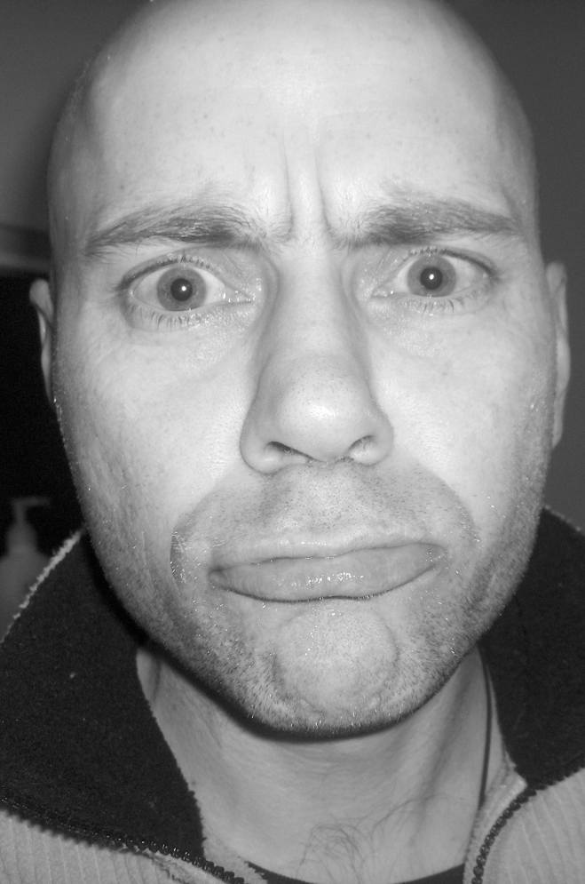
Life and all that I saw as
a part of me came crashing
down around me
Relationship with girlfriend
Took more notice of
coincidental events in
my everyday life
Close circle of Friends
Professionally Radiographer promotion did not evetuate which lacked fulfilment
Noticed this weird thing happening to my skin which seemed to happen when
I was deep in thought
Living with two
doctors changed my perspective on status
Started to document
events and write them down
not knowing what, why or
how things were happening
Addictions/Karmas

Slide 4
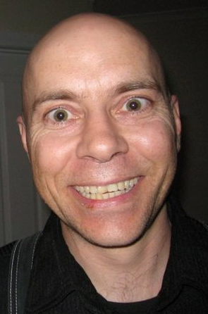
Too many coincidences
to be coincidences
Everything is Connected
A Supernatural experience
Cutaneous skin response,
confirming Spiritual Lore
The most bizarre experience I have ever
had both anatomically & psychologically
Interest in Human Anatomy & Physiology included the Human ‘Energy Field’
Addictions/Karmas
Continued to document
events and write them in
The “What on Earth is
Kundalini?” series book 1
‘Why the Astros?’
Happiness beyond Happiness

Slide 5
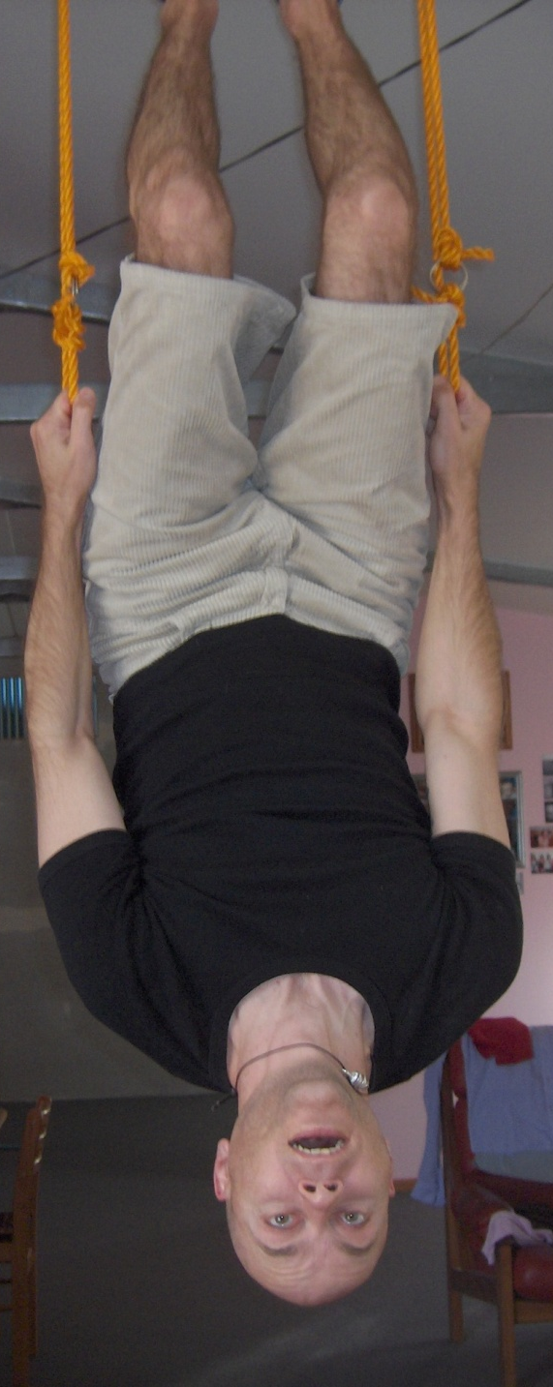
Turned my back
on my former life
Isolated myself, found a cave in the form of
Tasmania, Australia
Tied myself to the culture,
attempting to ground
in a quest to
‘Appear Normal’
Study of Human Biological Framework moved from the Physical Body to the Subtle Components
Addictions/Karmas
Realised that very specific
thoughts would manifest
as physical events
Psychic Research
Psychic Development
Shamanic Circles
Native Indian Circles
Theosophical Society
Religious Study
Tai Chi/Chi Kung
Continued to document
events and write them in
The “What on Earth is
Kundalini?” series book 2
‘Your Thoughts create
Your Reality’

Slide 6

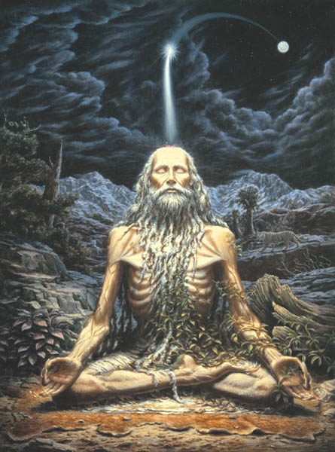
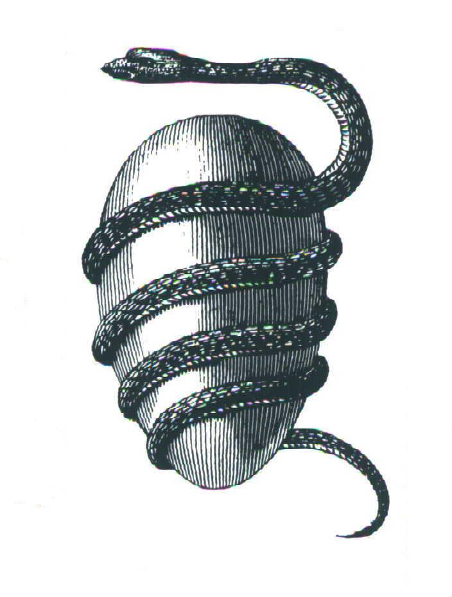
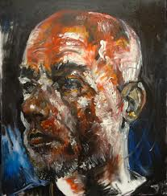
Tied to the culture,
attempting to ground
myself in a quest to
‘Appear Normal’
Local Yoga Chakra workshop
3 year Diploma, Satyananda
Yoga Teaching, Paramahamsa
Satyananda Saraswati
Addictions/Karmas
Contextualised events, wrote them in The “What on Earth is Kundalini?” series book 3
‘What on Earth is Kundalini?’
Realisation what I had
experienced had something
to do with ‘Kundalini’

Slide 7

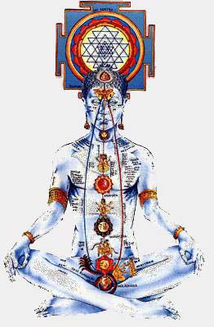
The Goal of Yoga
Anandamaya kosha
Rudra Granthi
Vijnanamaya kosha
Vishnu Granthi
Manamaya kosha
Brahma Granthi
Pranamaya kosha
Annamaya kosha
The Goal of Yoga is Scientific & Organic achieved Uniquely & Individually
relative to Psychological & Emotional predispositions & Elemental Constitution

Slide 8
My body connected to all via my DNA...
How is my DNA connected? Transmits and receives EMR.
How does that connect me? Via the Sthoola Prana/Prana Vayus
Prana Vayus connect to Suksma Prana in the Linga Sharira/Subtle Body
The Suksma Prana is responsible for all manifestations and expression of and by me.
How I am connected, in turn creates the events happening and yet to happen in my life.
How is the Linga Sharira anchored into my physical being?
Via the central column in the spinal cord known as the nadi Sushumna.
Within this channel are seven known junctions within the Linga Sharira affecting
everything physical and non physical within my being.
The great sages, seers and munis appreciated these major junctions
within the Linga Sharira as the Chakras.
Each Chakra having a specific number of ‘petals’ or smaller nadis. Fifty to be precise.
Each one of the fifty channels corresponds directly to the vibration, frequency, tone
and appearance of one specific letter of the Sanskrit alphabet.
The 50 Matrikas, Devanagari – the abode of the Gods

Slide 9
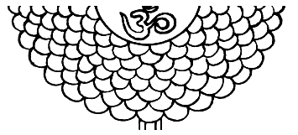
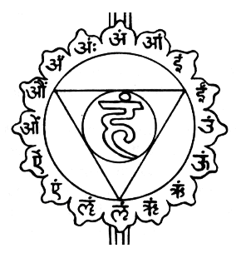
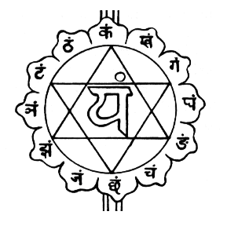
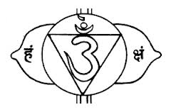
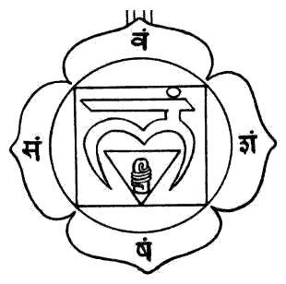
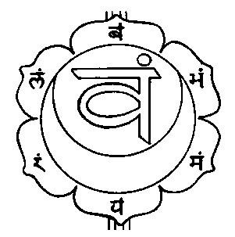
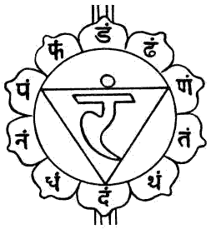

Slide 10
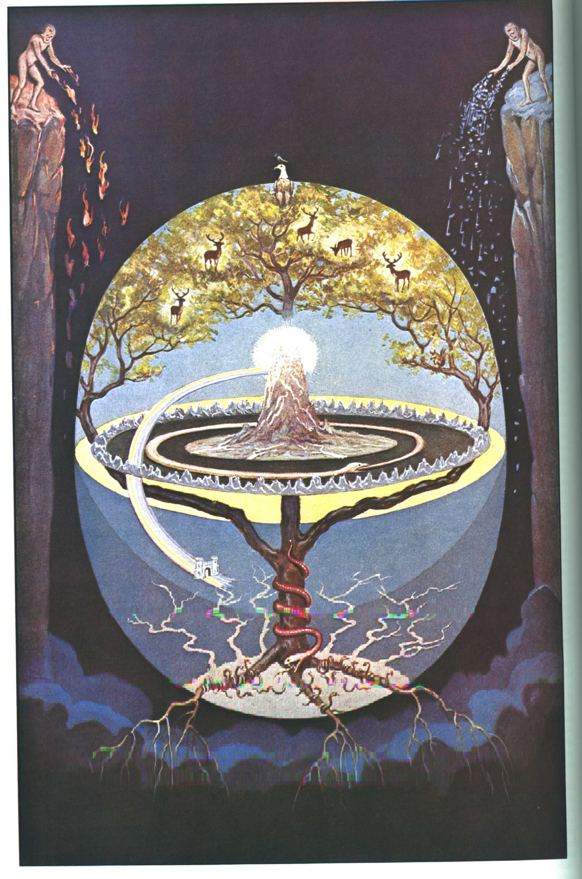
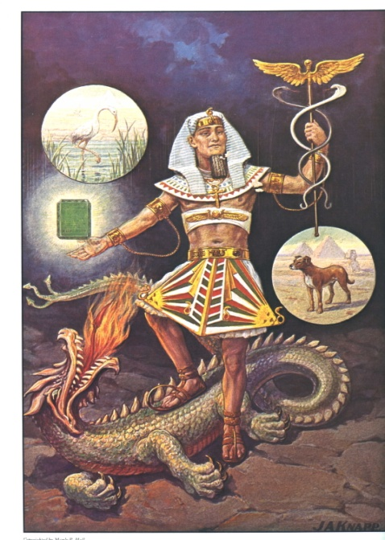
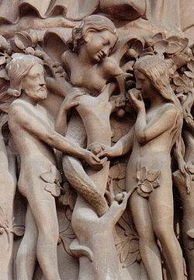
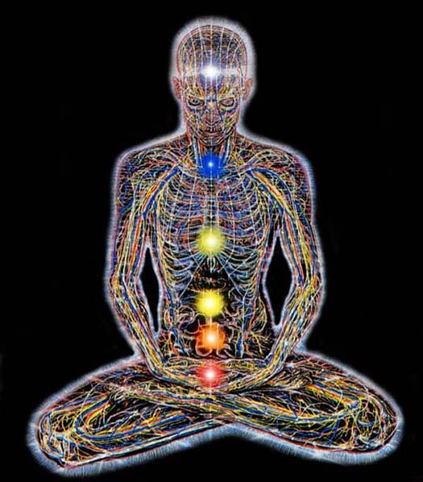
Current Western Culture
Financially Controlled
Spiritually Oppressed
Conscious Awareness
Three lower Chakras
Below Brahma Granthi
Three denser Koshas
Seperate from everything
Animal that has evolved
Saving Grace
The impulse of Kundalini
Yogic knowledge throughout the world
Man at the peak of physical investigation
Quantum Physics
Earths location
Collective consciousness Manipura to Anahata
Yoga and Sanatan Dharma
Controlled by Life
Spiritually Educated
Consciousness
Aware of Seven Chakras
Aware of Three Granthis
Aware of Five Koshas
Connected to everything
Soul Incarnate/Involuted

Slide 11
Credits
Sheshnaag Yoga Centre – ‘Share the World’
The “What on Earth is Kundalini?” series – MJ Perring/omdevaji
Satyananda/Bihar Yoga Association
The Secret Teachings of All Ages – Manly P Hall
www.rickrichards.com & www.fuchsiastars.com

