Slide 1
What on Earth is Kundalini?
The Spiritual Adventure continues
How it has shaped me and what I have to offer
by ‘omdevaji’

Slide 2
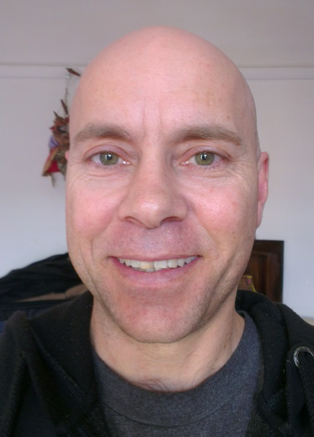
I am a Human Being
I was relatively ‘normal’ until the 12th July 1998
My interests were Human Anatomy, Women, Sports, Making Money, Smoking Marijuana, Following the ‘Life Plan’ & Chi
By ‘normal’ I mean – determined, intelligent, ignorant & selfish

Slide 3
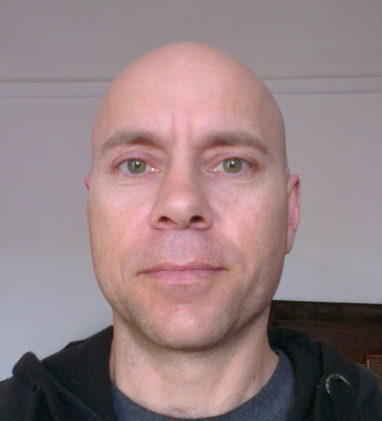
Interested in the Human Body
I enjoyed subjects such as Biology (Anatomy & Physiology) & Physics
With an interest in Chi, progressed into the Mind and subtle components of me
I went on to study Radiography & Massage
I realised there is no coincidence, stumbled upon God and had 2 Mystical experiences

Slide 4
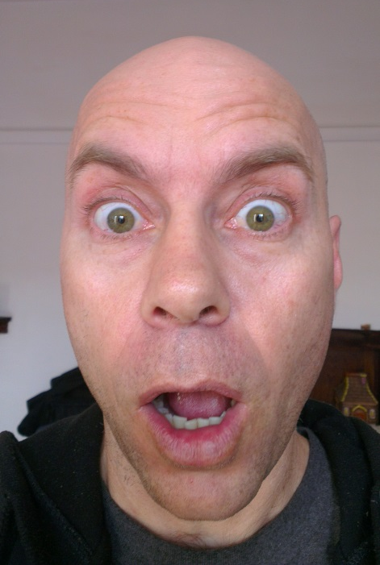
The 2 Mystical experiences
After 6 months of questioning the events in my life
Seated in a church I had a dialogue with God in my mind as Spontaneous Nauli (rotation & contraction of the abdominal muscles) occurred
Driving home, I decided to ‘turn right’ my hand moved and ‘indicated left’

Slide 5
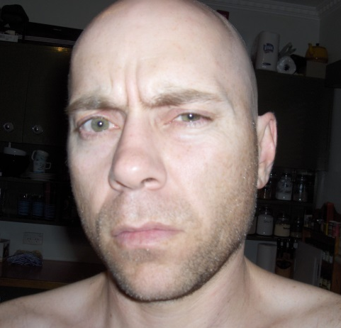
My response
Untold and unexperienced Ecstasy
I quit my Job
I turned my back on my former life and moved to Tasmania
I told people about it to share the Joy
I isolated myself, studied everything
I questioned EVERYTHING
I was labelled ‘Insane’ and ostracized

Slide 6
The Outcome after 17 years
& what I have to offer
The “What on Earth is Kundalini?” series
The ‘Goal of Yoga’ Documentary
Sheshnaag Mandir
Sheshnaag Sanskrit Museum & library
Sheshnaag & www.sheshnaag.com
Sheshnaag Sanskrit School (Not for Profit)
Sheshnaagyogacentre on Youtube
I am undiagnosable
Doctors $50,000 Challenge

Slide 7
The “What on Earth is Kundalini?” series
Book I – Why the Astros?
Book II – Your Thoughts create Your Reality?
Book III – What on Earth is Kundalini?
Book IV - A Pocketbook on Kundalini
A Retrospective Anatomical Interpretation of Spiritual Illumination & the ‘Goal Of Yoga’

Slide 8
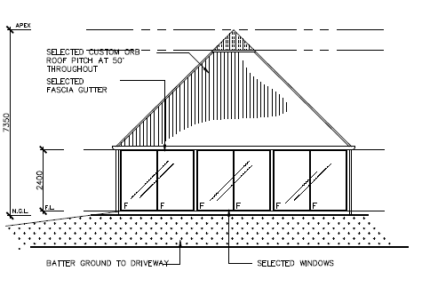
Sheshnaag Mandir
A Temple dedicated to Sanskrit, The Medical Symbol & the ‘Goal Of Yoga’ acknowledging how humans are “Born in the Image of the Creator” according to Yogic Philosophy

Slide 9
The ‘Goal of Yoga’ Documentary
Filmed during the Kumbha Mela 2013 in Allahabad/Prayag, India
8+ hours of footage and interviews from some of the most ‘esteemed’ Yogis on the planet
Interviews are with
Sri Sri Ravi Shankar, Pilot baba,
Maheshwarananda,
Jasraji Puri, 3 Shankaracharyas
Baba Ramananda
Naresh Triparthi Tantrik Mahendra & many more

Slide 10
Sheshnaag Sanskrit School (Not for Profit)
Established and Incorporated in 2015
Credentials and Assets for Sheshnaag and ‘omdevaji’
Author of the “What on Earth is Kundalini?” series
Diploma in Satyananda Yoga Teaching
¾ Masters of Sanskrit
Building Approval for Sheshnaag & Sheshnaag Mandir
5 Acre Property located in Tasmania Australia
Mission: to promote the Sanskrit alphabet, Yogic Philosophy, Atmajnana and Sanatana Dharma

Slide 11
‘Sheshnaagyogacentre’ on Youtube
Tantrik mahendra
Kundalini like never before
Kamadeva Mantra
Dhanada Mantra
Ganga Worship
The Four Mokshas
Symbology of the Trishul
‘omdevaji’
The Yoga Sheshnaag Teaches
The Garden of Eden, the Medical Symbol and the Goal of Yoga
Sheshnaag Yoga Nidra
The System that Yoga works on
“What on Earth is Kundalini?” Series Summary
Yogic Breath Lesson
All videos and meditations from ‘Sheshnaagyogacentre’ are free with the option to donate or contribute towards Sheshnaag.com
Om Namah Sheshnaaga

Slide 12
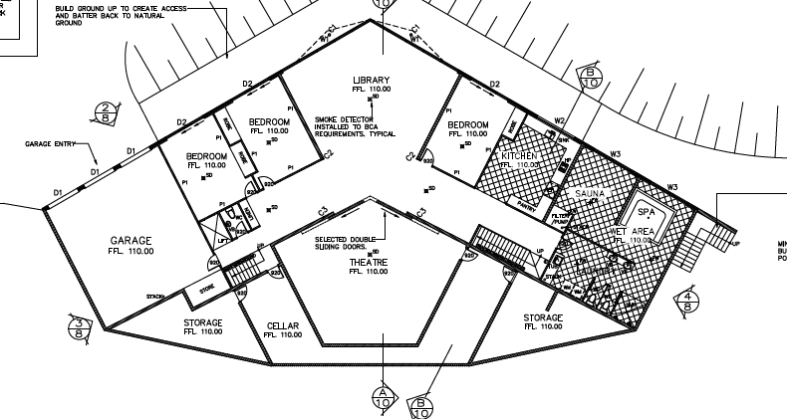
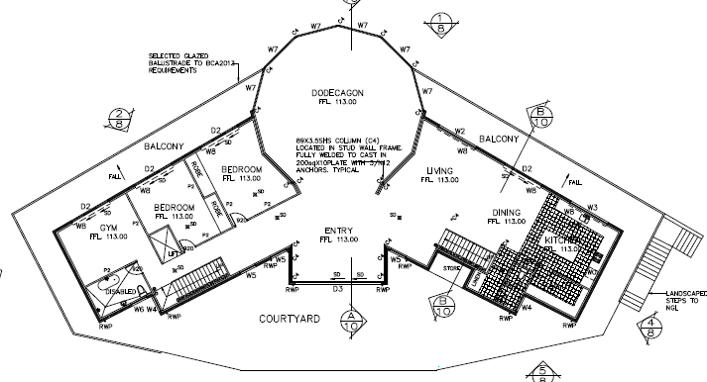
Sheshnaag Sanskrit Museum & Library
Sheshnaag Yoga Centre aims to focus on the Sanskrit Alphabet, the culture of ‘Sanatana Dharma’ and teaches and encourages the Yoga of Self Knowledge (Atmajnana) . Jnana Yoga utilises a focused mind to achieve intuitive insight into the various dimensions of being.
The primary goal of Sheshnaag is to create an atmosphere where the environment, information and people within it provide individuals with the opportunity to work towards the realisation and direct experience of the most subtle nature of the human mind body framework.

Slide 13
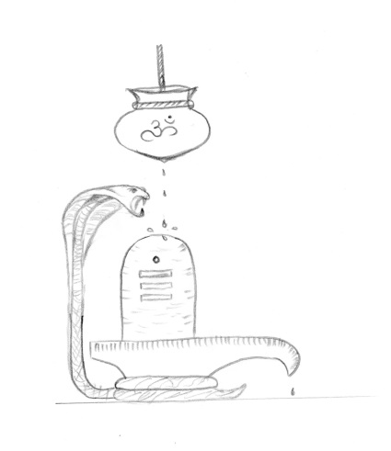

I am undiagnosable
I have a doctor, chiropractor, counsellor and psychologist.
None of them can diagnose me for several reasons:
I embody personality traits of several ‘schizotypal’ behaviours.
The depth of Yoga relating to the Goal of Yoga, Kundalini and Sanskrit are not accurately understood in the western Culture.
We still believe we are ‘Monkeys that have grown to talk’ on a linear path of evolution (irrespective of the Pyramids) rather than Souls incarnate in a human vehicle for evolution of consciousness.
In 20+ years of working in Hospitals I have not found one Psychologists that understands Kundalini or endorses the experience of ‘Spiritual illumination’ or ‘Enlightenment’
Youtube channel : sheshnaagyogacentre
Video Title : I am undiagnosable because Kundalini is unknown in the west
Youtube link : https://www.youtube.com/watch?v=i0209SIjmmo

Slide 14
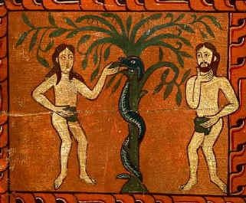

Doctors $50,000 Challenge
Research is Purely Anatomical..
Not Religious, Dogmatic or Someone else's.
I did not want to feel better or be stress free and through intuitive perception I stumbled upon the experience of ‘Spiritual Illumination’.
Since 1998 I have researched two ‘mystical experiences’ which lead me to understand the meaning of Yoga and the affect of Kundalini and Sanskrit.
I can anatomically correlate the ‘Medical Symbol to ‘Adam & Eve’ in the garden of Eden and the ‘Goal of Yoga’ and offer $50,000 to anyone that can convince me to the contrary
Youtube channel : sheshnaagyogacentre
Video Title : The Garden of Eden, the Medical Symbol and the Goal of Yoga
Youtube link : https://www.youtube.com/watch?v=Du41AOl-4rQ

Slide 15
To Assist Sheshnaag
Download free or Buy The “What on Earth is Kundalini?” series
Provide production advice or help edit The ‘Goal of Yoga’ Documentary
Donate towards Sheshnaag Mandir
Provide feedback to Sheshnaag & www.sheshnaag.com
Watch free Videos ‘Sheshnaagyogacentre’ on Youtube
Donate to Sheshnaag Sanskrit School (Not for Profit)
Donate towards Sheshnaag Sanskrit Museum & library
Spread the word about the Doctors $50,000 Challenge
Thank You for watching – “Om Namah Sheshnaaga” omdevaji

